Slide 2
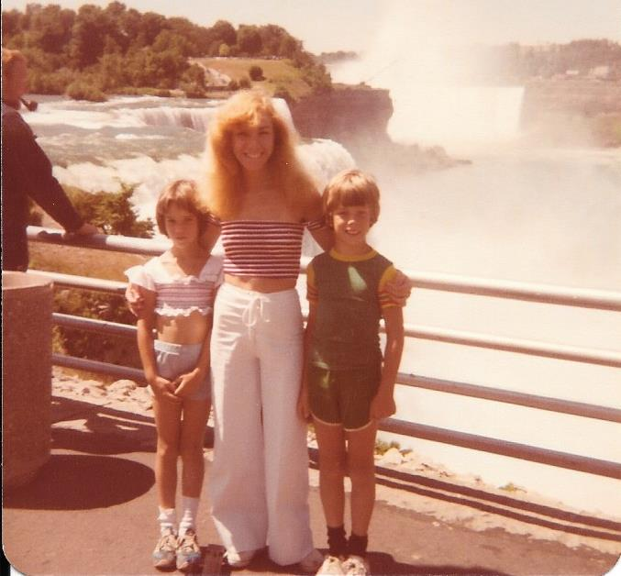
Notes:
When I was still relatively young, my mother lost control of her car when it hit a patch of ice two days before Christmas. Her car spun off the road, her seat collapsed, and she experienced a traumatic brain injury. She survived but she never recovered even to the point of recognizing my sister and me. She required full-time care for the rest of her life, and it devastated my family.

Slide 3
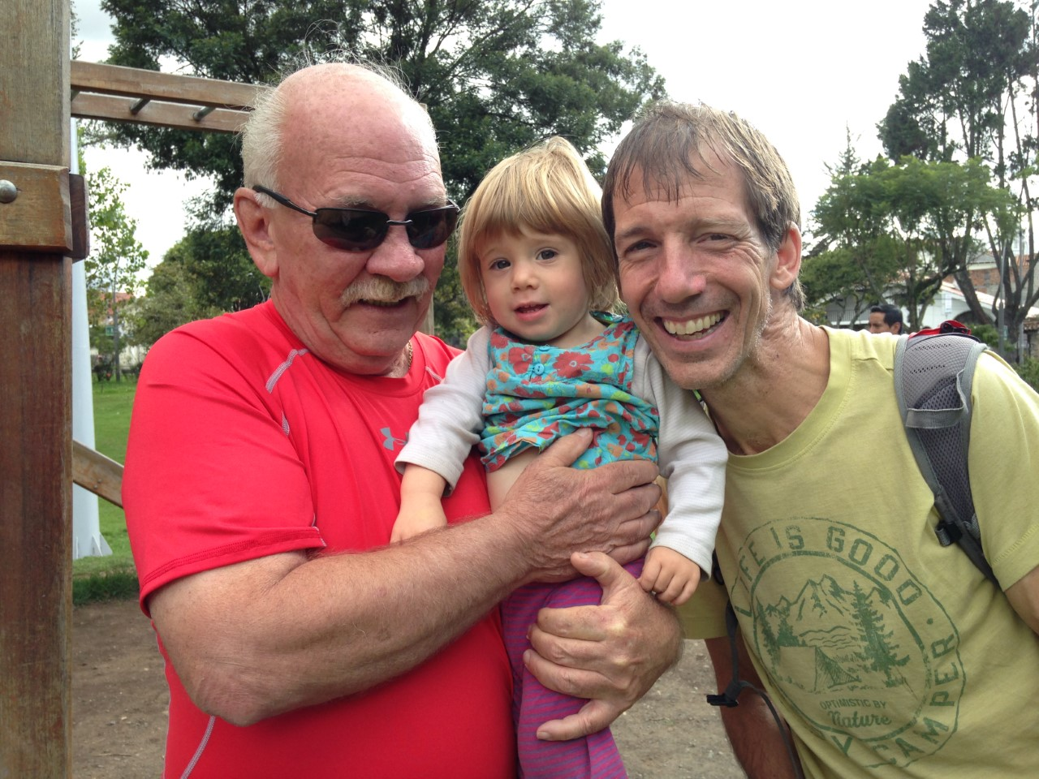
Notes:
My dad is a good man. He devotedly stayed home for 25 years rather than work so that he could care for my mom at home rather than commit her to an institution. My dad is a good man who he has struggled with his use of alcohol for his entire adult life. At times, it was in the background of our lives. At other times, it was severe. He is almost 80 years old now and he has never received any treatment. It breaks my heart, but it is not surprising.

Slide 4
Notes:
We have a mental health crisis in the U.S. and it is a crisis of **unmet** high need because our delivery of mental healthcare is deeply flawed. In 2019, well over half of the 52 million individuals in the U.S. with an active mental illness did not receive **any** treatment. **More than half**! And for those suffering with a substance use disorder - like my dad - it was worse still. **9 out of 10 people** with substance use disorders did not receive any treatment at all. Our failure to provide treatment has tragic consequences. In the past 12 months alone, almost **100,000 people** have died from drug overdoses.

Slide 5
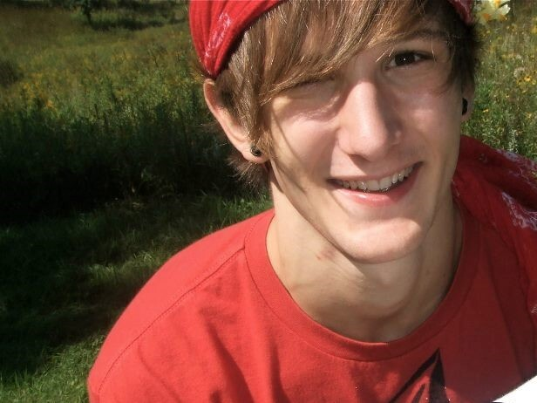
Notes:
And these are not just big numbers, they are real people. One of them was Victor Kittleson, the 29 year old brother of my graduate student, who died from an opioid overdose this past summer.

Slide 6
Notes:
We have a mental health crisis in the U.S. and it is a crisis of **unmet** high need because our delivery of mental healthcare is deeply flawed. In 2019, well over half of the 52 million individuals in the U.S. with an active mental illness did not receive **any** treatment. **More than half**! And for those suffering with a substance use disorder - like my dad - it was worse still. **9 out of 10 people** with substance use disorders did not receive any treatment at all. Our failure to provide treatment has tragic consequences. In the past 12 months alone, almost **100,000 people** have died from drug overdoses.

Slide 7
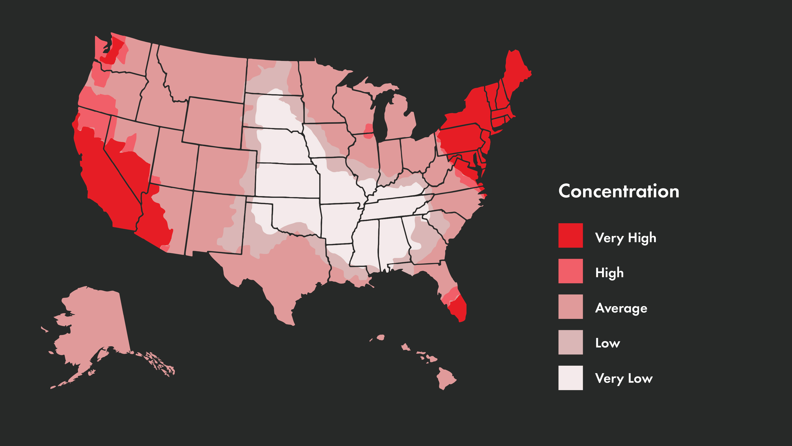
County Level Distribution of Therapists
County Level Distribution of Therapists
https://www.apa.org/monitor/2016/03/datapoint
https://www.apa.org/monitor/2016/03/datapoint

Slide 8
Notes:
We have a mental health crisis in the U.S. and it is a crisis of **unmet** high need because our delivery of mental healthcare is deeply flawed. In 2019, well over half of the 52 million individuals in the U.S. with an active mental illness did not receive **any** treatment. **More than half**! And for those suffering with a substance use disorder - like my dad - it was worse still. **9 out of 10 people** with substance use disorders did not receive any treatment at all. Our failure to provide treatment has tragic consequences. In the past 12 months alone, almost **100,000 people** have died from drug overdoses.

Slide 9

/beta.png
Image courtesy of Shutterstock
Notes:
OK, so lets call the apps I have described to you so far, the beta version of digital therapeutics. Their power arises from easy, 24/7 access to their rich and diverse set of supports - their interventions, tools, and services.

Slide 10
Notes:
We have a mental health crisis in the U.S. and it is a crisis of **unmet** high need because our delivery of mental healthcare is deeply flawed. In 2019, well over half of the 52 million individuals in the U.S. with an active mental illness did not receive **any** treatment. **More than half**! And for those suffering with a substance use disorder - like my dad - it was worse still. **9 out of 10 people** with substance use disorders did not receive any treatment at all. Our failure to provide treatment has tragic consequences. In the past 12 months alone, almost **100,000 people** have died from drug overdoses.

Slide 11
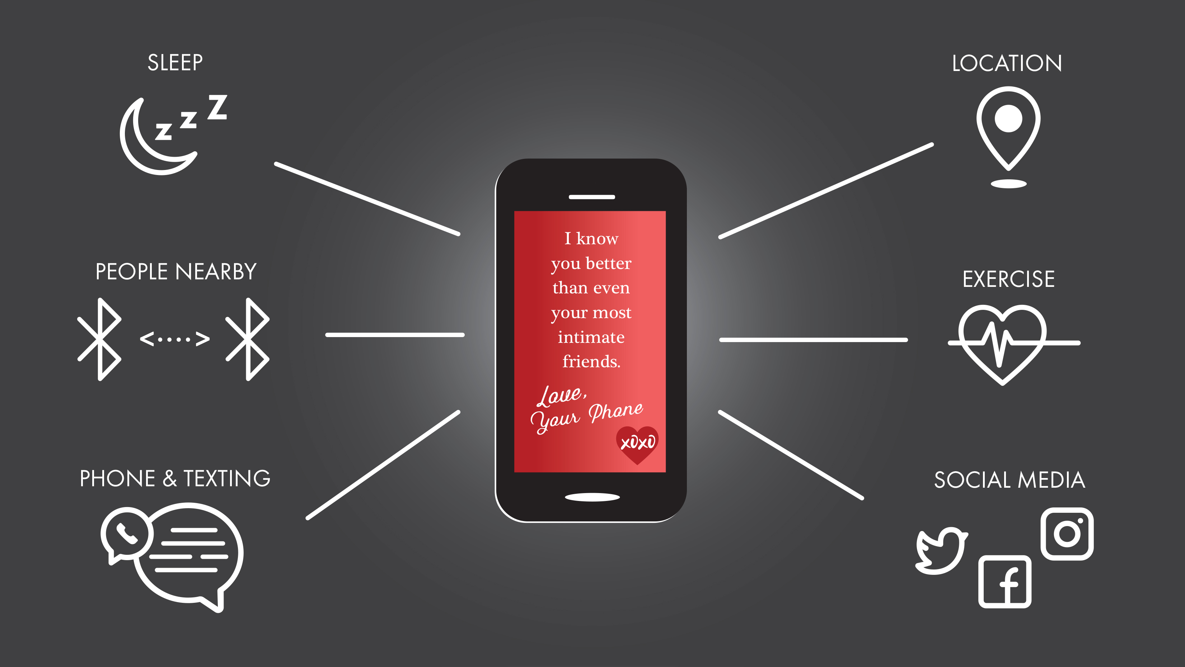

Slide 12
Notes:
We have a mental health crisis in the U.S. and it is a crisis of **unmet** high need because our delivery of mental healthcare is deeply flawed. In 2019, well over half of the 52 million individuals in the U.S. with an active mental illness did not receive **any** treatment. **More than half**! And for those suffering with a substance use disorder - like my dad - it was worse still. **9 out of 10 people** with substance use disorders did not receive any treatment at all. Our failure to provide treatment has tragic consequences. In the past 12 months alone, almost **100,000 people** have died from drug overdoses.

Slide 13
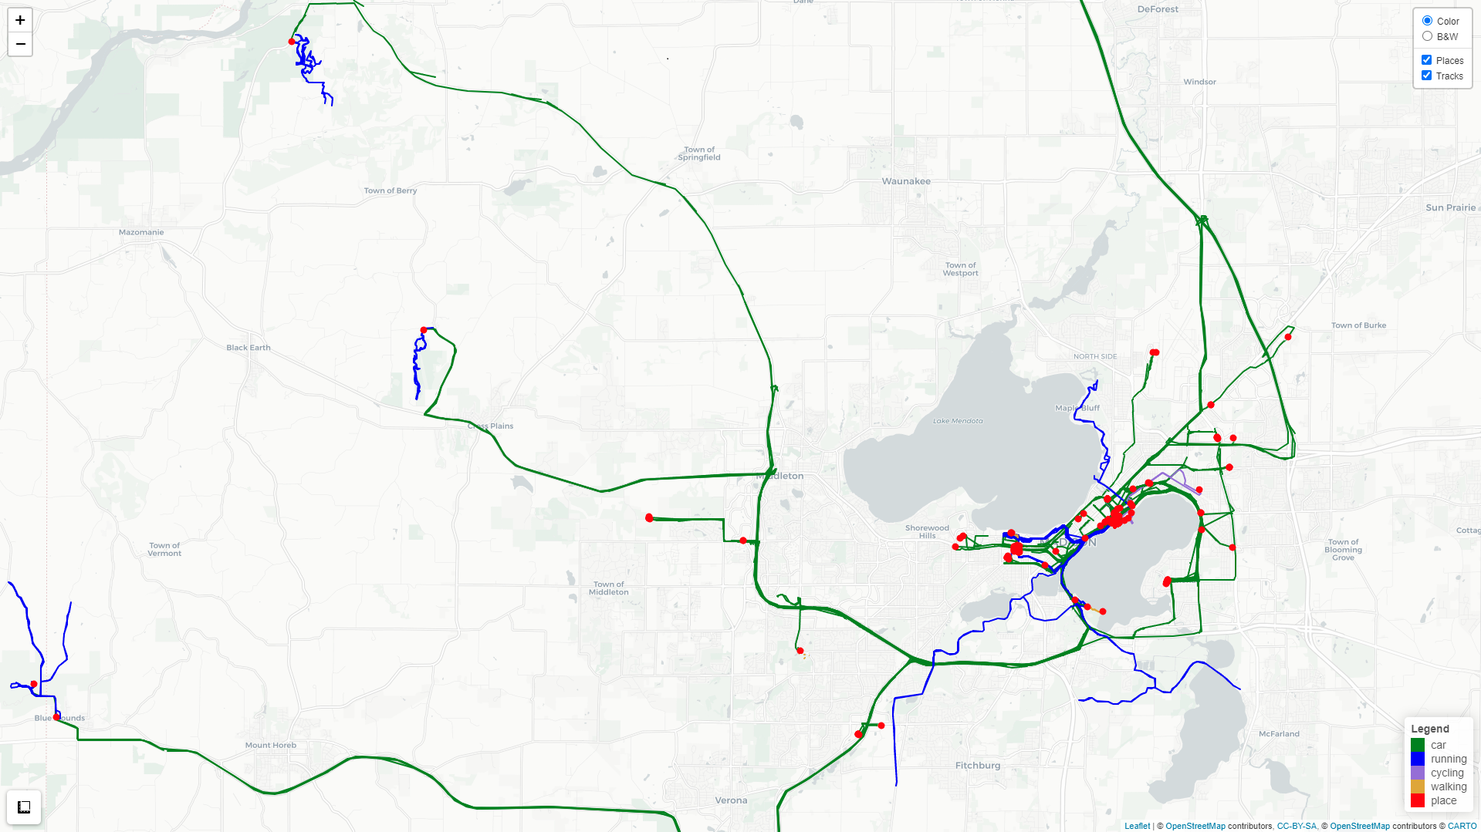
/gps_1.png
Notes:
Let's "look under the hood" so to speak at two of the more revealing personal sensing methods that we are developing to provide you with some intuition about how this works. Behind me is a wide view of my moment-by-moment location detected by my smartphone over a month when we were first experimenting with this personal sensing method. You can see the paths that I traveled, with movement by car in yellow and running in blue. The points in red indicate places that I stopped to visit for at least a few minutes.
And although not displayed here, we know the days and exact times that I was at each location. As my smartphone ads already know, you can immediately see that I am runner, with long runs leaving from downtown Madison and frequent trail runs in the county and state parks to the west and northwest.

Slide 14
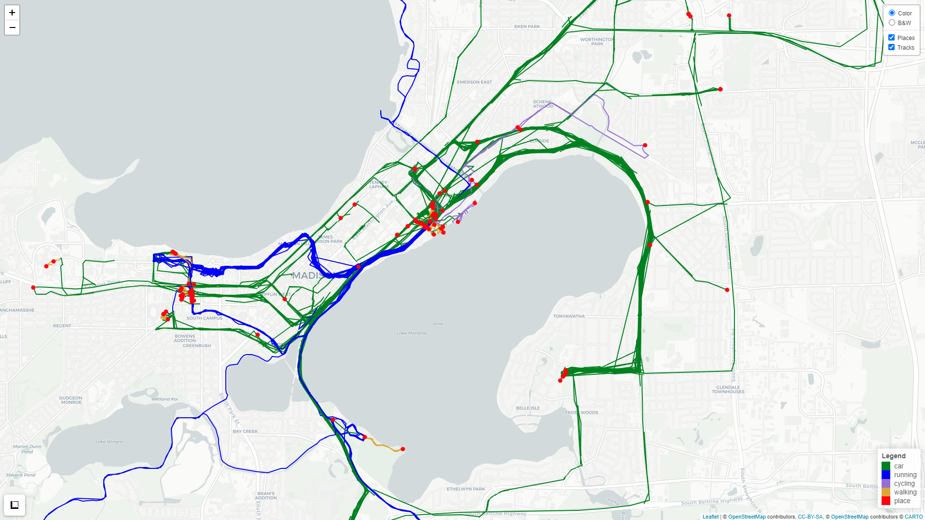
/gps_2.png
Notes:
Zooming in to the Madison isthmus, you can see dense clusters of red dots indicating places visited near my home and where I work at the University of Wisconsin. You can see that I drive my children clockwise around the lake each morning to their elementary school. And you could detect those stressful mornings when getting my young kids dressed and fed didn't go as planned and we were late, sometimes very late, to school! You can see my daily running commute to and from my office. From this, you can observe the long days, and short days, at the office. If you probed the red dots indicating the places I visited, you would find the restaurants, bars, and coffee shops where I eat, drink and socialize. We can use public map data to identify these places and make inferences about what I do there.

Slide 15
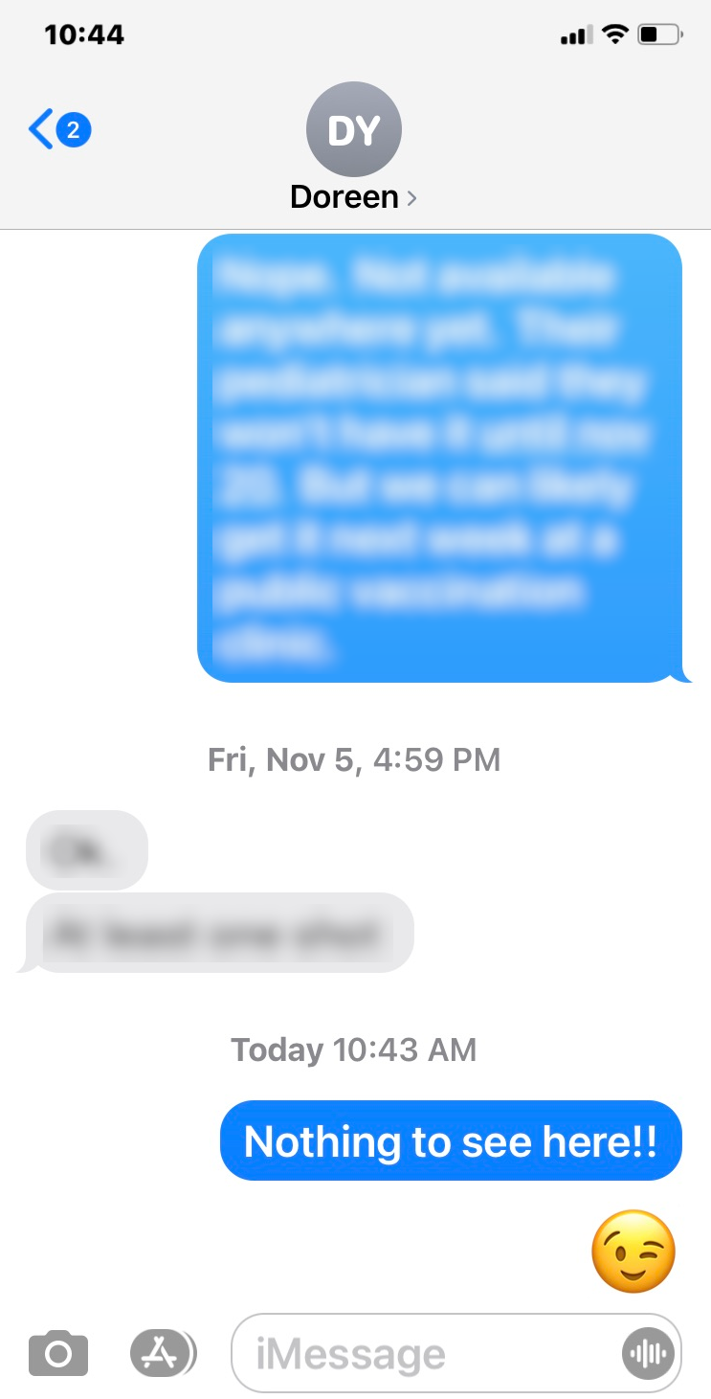
Notes:
We have a mental health crisis in the U.S. and it is a crisis of **unmet** high need because our delivery of mental healthcare is deeply flawed. In 2019, well over half of the 52 million individuals in the U.S. with an active mental illness did not receive **any** treatment. **More than half**! And for those suffering with a substance use disorder - like my dad - it was worse still. **9 out of 10 people** with substance use disorders did not receive any treatment at all. Our failure to provide treatment has tragic consequences. In the past 12 months alone, almost **100,000 people** have died from drug overdoses.

Slide 16
Notes:
We have a mental health crisis in the U.S. and it is a crisis of **unmet** high need because our delivery of mental healthcare is deeply flawed. In 2019, well over half of the 52 million individuals in the U.S. with an active mental illness did not receive **any** treatment. **More than half**! And for those suffering with a substance use disorder - like my dad - it was worse still. **9 out of 10 people** with substance use disorders did not receive any treatment at all. Our failure to provide treatment has tragic consequences. In the past 12 months alone, almost **100,000 people** have died from drug overdoses.

Slide 17

Image courtesy of Shutterstock
Notes:
I also suspect that at some point, probably about five minutes ago, you also thought: > "Holy crap, this is really private information that these apps would collect from me. Who will have access to it and what will they do with it?" Most of us are too familiar with recent egregious privacy violations including the Facebook Cambridge Analytica scandal and the more recent WhatsApp Pegasus Spyware scandal. Given this, you might be surprised to hear me say that I am generally optimistic that we will get these privacy issues resolved, at least narrowly in the context of digital therapeutic apps. I'm not making any promises for other apps on your phone or god forbid, Facebook! You're on your own there.....

Slide 18
Notes:
We have a mental health crisis in the U.S. and it is a crisis of **unmet** high need because our delivery of mental healthcare is deeply flawed. In 2019, well over half of the 52 million individuals in the U.S. with an active mental illness did not receive **any** treatment. **More than half**! And for those suffering with a substance use disorder - like my dad - it was worse still. **9 out of 10 people** with substance use disorders did not receive any treatment at all. Our failure to provide treatment has tragic consequences. In the past 12 months alone, almost **100,000 people** have died from drug overdoses.

Slide 19

Image courtesy of Shutterstock
Notes:
So here's why I'm optimistic. In the last five years, the FDA recognized both the potential benefits and risks to public health posed by digital therapeutics. In response, the FDA has now clarified that it intends to regulate software, including mobile apps, as it does other medical devices if the purpose of that software is to prevent, manage, or treat disease. This means that the FDA now evaluates the effectiveness and risks, including privacy risks, of digital therapeutics before clearing them for use with patients. These FDA policy changes are huge and they begin to situate digital therapeutics squarely within healthcare, where privacy protections have been considered paramount.
This FDA guidance was also designed to provide the clarity and predictability necessary to stimulate further development, innovation, and investment in digital therapeutics. And, in fact, the FDA has already followed through and recently cleared two new digital therapeutics to help people manage and treat substance use disorders.

Slide 20
Notes:
Digital therapeutics are here today. And as they begin to add personal sensing capabilities, we can start to imagine what precision mental healthcare might look like — “delivering the right treatments, at the right time, to the right person, every time”
My dad did not receive the mental healthcare he needed. Neither did Victor Kittleson. In large part, my work now is driven so that others don't suffer similarly.

Slide 21
Notes:
Digital therapeutics are here today. And as they begin to add personal sensing capabilities, we can start to imagine what precision mental healthcare might look like — “delivering the right treatments, at the right time, to the right person, every time”
My dad did not receive the mental healthcare he needed. Neither did Victor Kittleson. In large part, my work now is driven so that others don't suffer similarly.

Slide 22
Notes:
Digital therapeutics are here today. And as they begin to add personal sensing capabilities, we can start to imagine what precision mental healthcare might look like — “delivering the right treatments, at the right time, to the right person, every time”
My dad did not receive the mental healthcare he needed. Neither did Victor Kittleson. In large part, my work now is driven so that others don't suffer similarly.

Slide 23
Notes:
Digital therapeutics are here today. And as they begin to add personal sensing capabilities, we can start to imagine what precision mental healthcare might look like — “delivering the right treatments, at the right time, to the right person, every time”
My dad did not receive the mental healthcare he needed. Neither did Victor Kittleson. In large part, my work now is driven so that others don't suffer similarly.

Slide 24
Notes:
Digital therapeutics are here today. And as they begin to add personal sensing capabilities, we can start to imagine what precision mental healthcare might look like — “delivering the right treatments, at the right time, to the right person, every time”
My dad did not receive the mental healthcare he needed. Neither did Victor Kittleson. In large part, my work now is driven so that others don't suffer similarly.

Slide 25
Notes:
Digital therapeutics are here today. And as they begin to add personal sensing capabilities, we can start to imagine what precision mental healthcare might look like — “delivering the right treatments, at the right time, to the right person, every time”
My dad did not receive the mental healthcare he needed. Neither did Victor Kittleson. In large part, my work now is driven so that others don't suffer similarly.

